Slide 1
JavaScript Lab 1
JavaScript for React
Notes:
Hello everyone and welcome to this lesson, where we are going to do a quick overview of JavaScript

Slide 2
1 Mathematical expressions
JavaScript for React

Slide 3
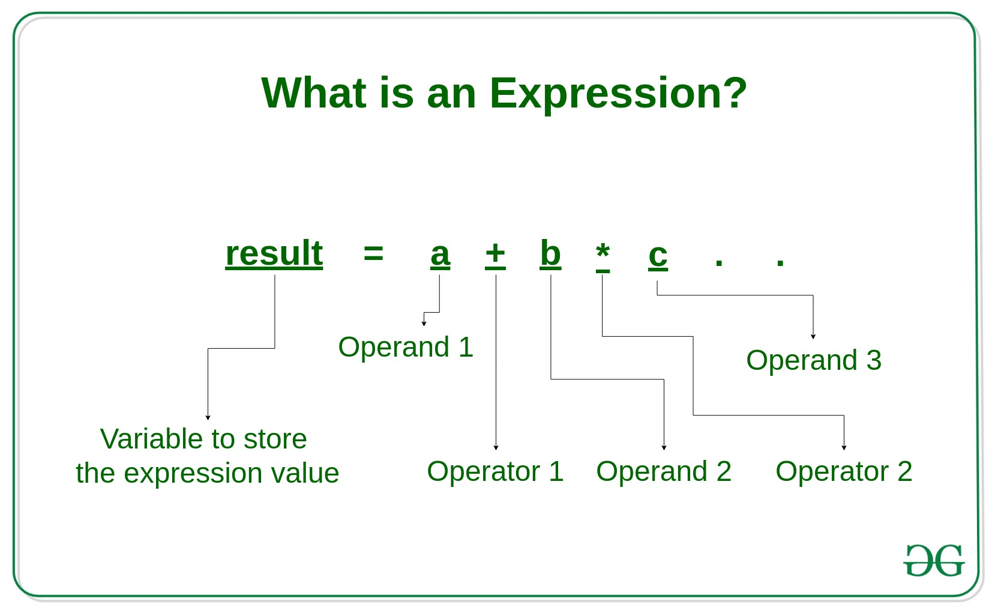
Evaluating an expression

Slide 4
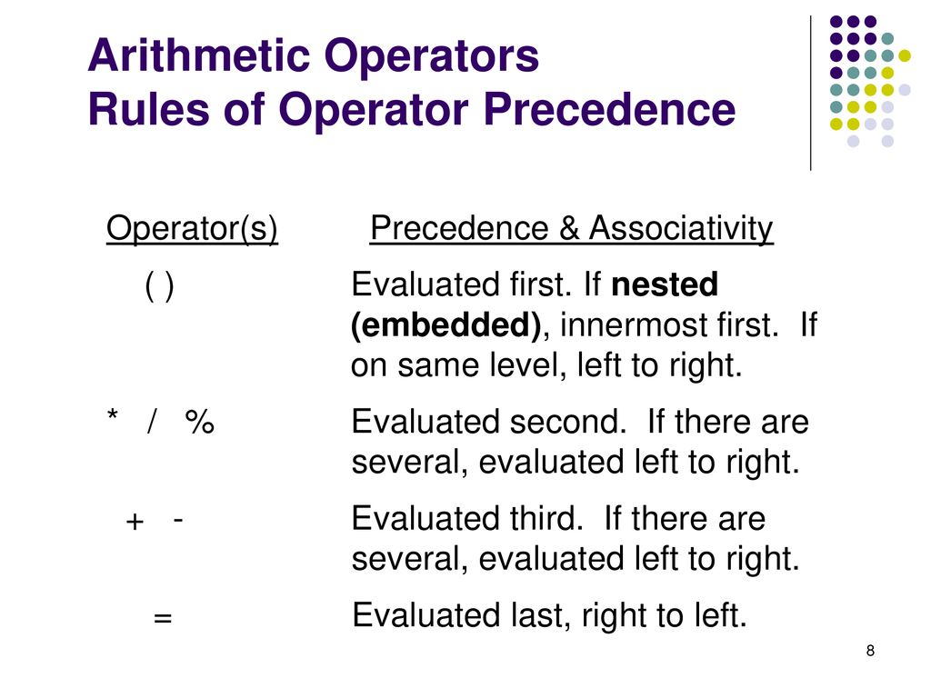
Operator precedence rules

Slide 5
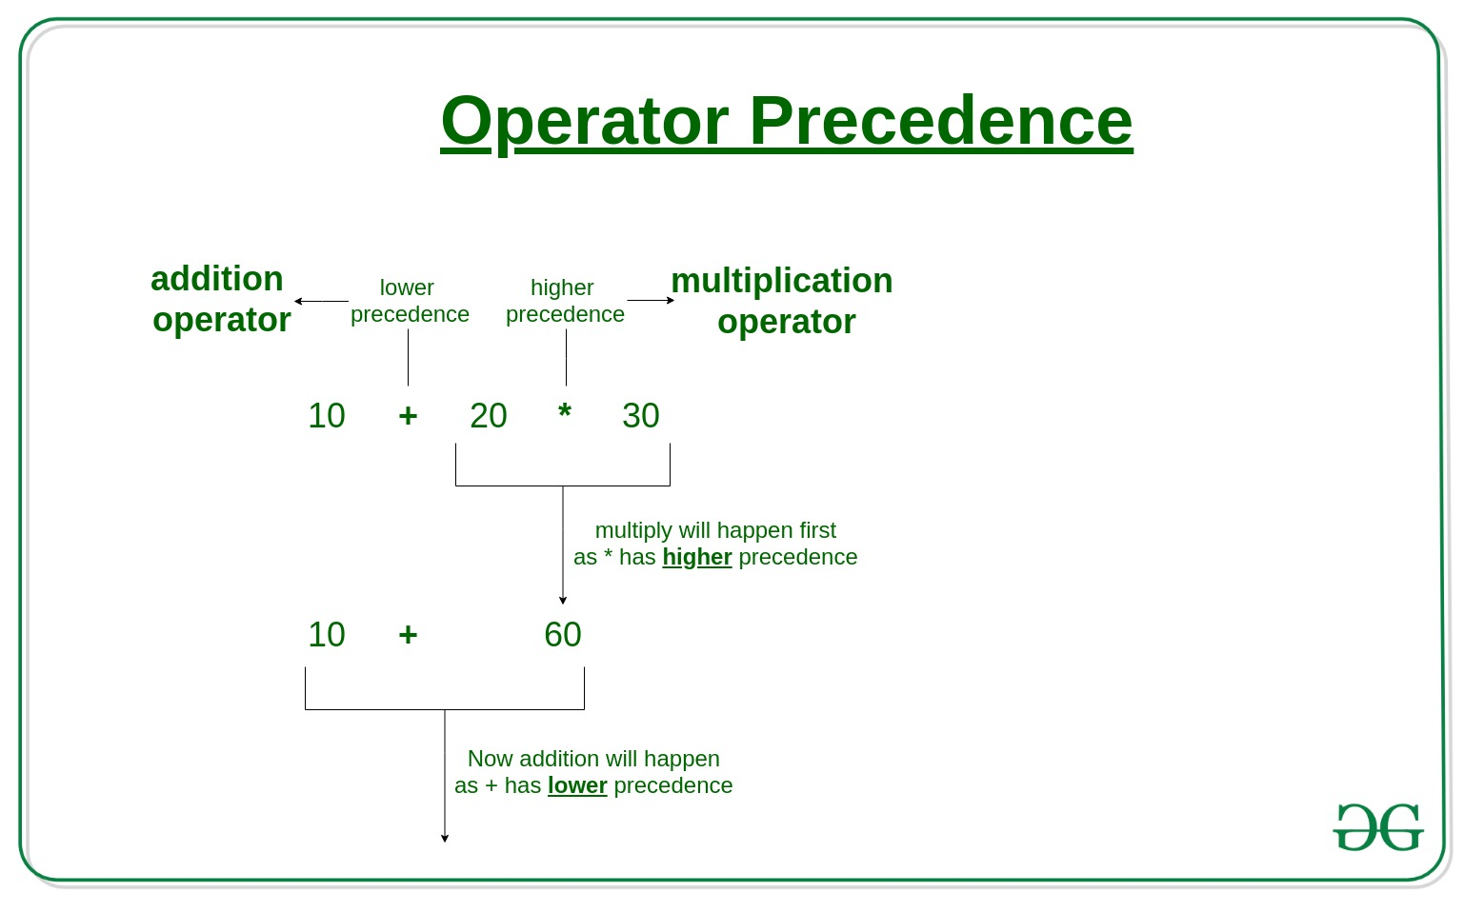
600

Slide 6
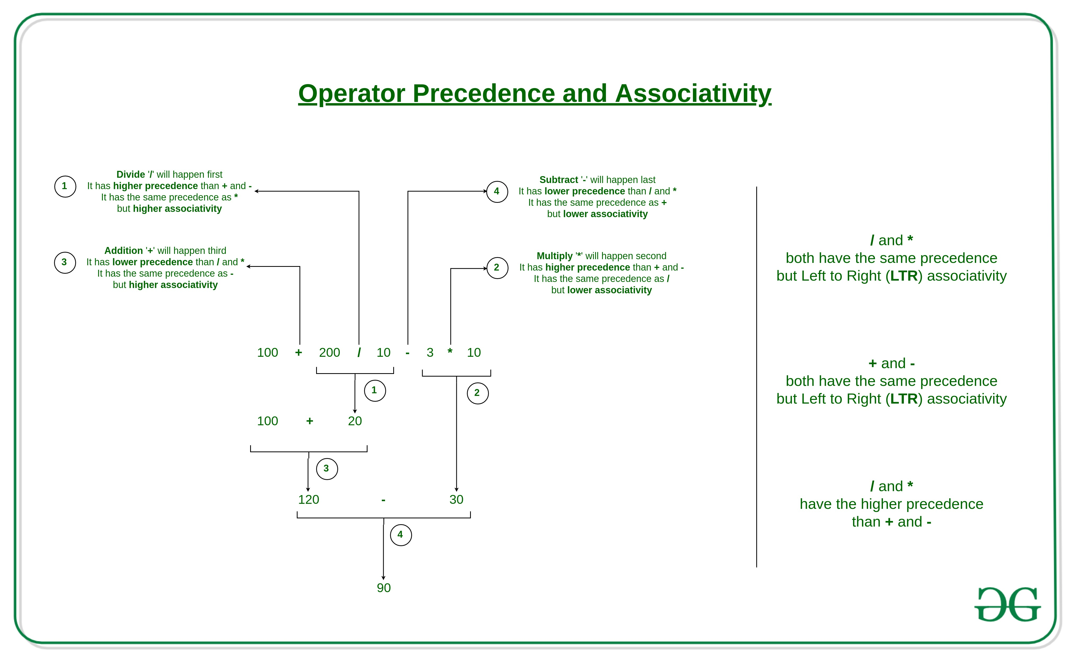

Slide 7
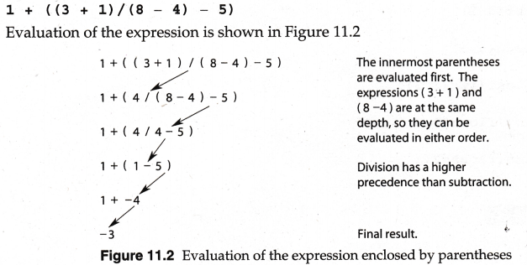
Operator precedence demo

Slide 8
2 Comparison and logical operators
JavaScript for React

Slide 9
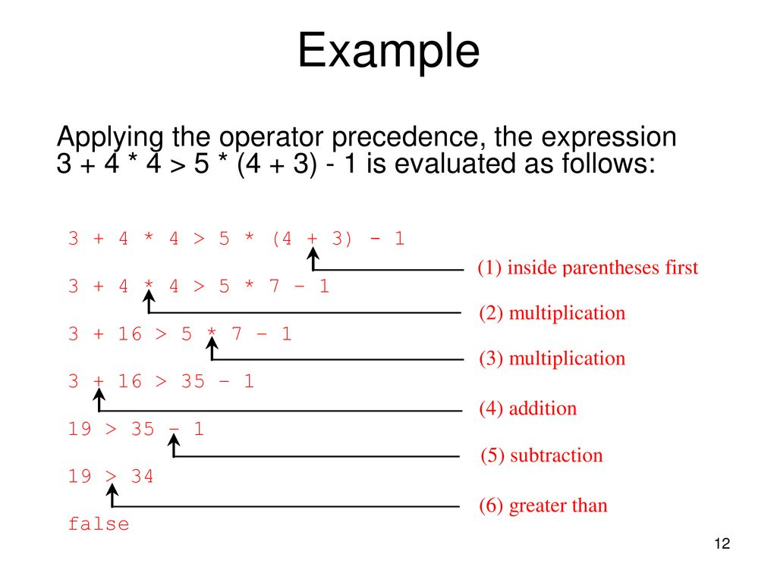
Operator precedence demo

Slide 10
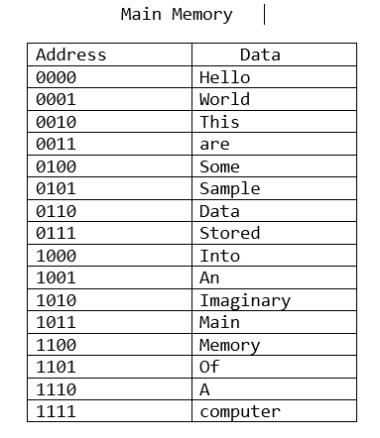
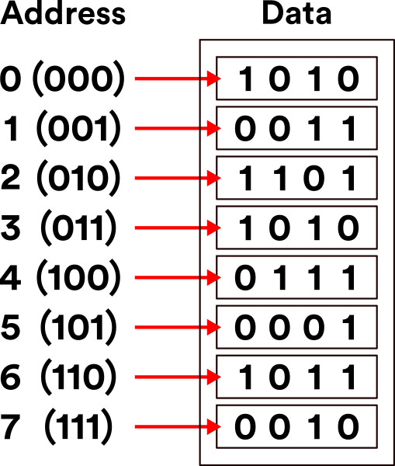
Computer memory (RAM)
RAM consists of many memory locations that store data
Each location has an address and can store a fixed amount of data

Slide 11
Storing strings in memory
ASCII Code
80
101
116
101
114
P
e
t
e
r

Slide 12
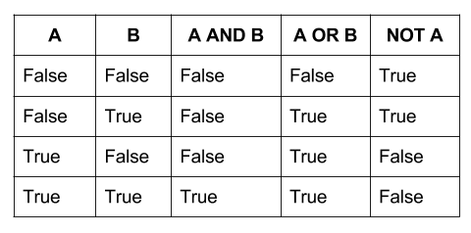
Truth table (OR, AND, NOT)
A && B
A || B
!A

